Slide 1
Network Sniffing &
Wifi Hacking
Presenting Muhammad Bilal & Muhammad Haris

Slide 2
Advanced Wireless Network Security and Attacks
1. Hacking Public Wi-Fi Hotspots
Introduction Public Wi-Fi hotspots are ubiquitous in today's digital age, found in cafes, airports, libraries, and other public places. However, their convenience comes with significant security risks, making them attractive targets for attackers.
1.1 Understanding Public Wi-Fi Vulnerabilities
Public Wi-Fi Characteristics:
Unencrypted Traffic: Often lacks encryption, making data transmission susceptible to eavesdropping.
Lack of Authentication: No requirement for users to authenticate, which makes it easy for unauthorized users to connect.

Slide 3
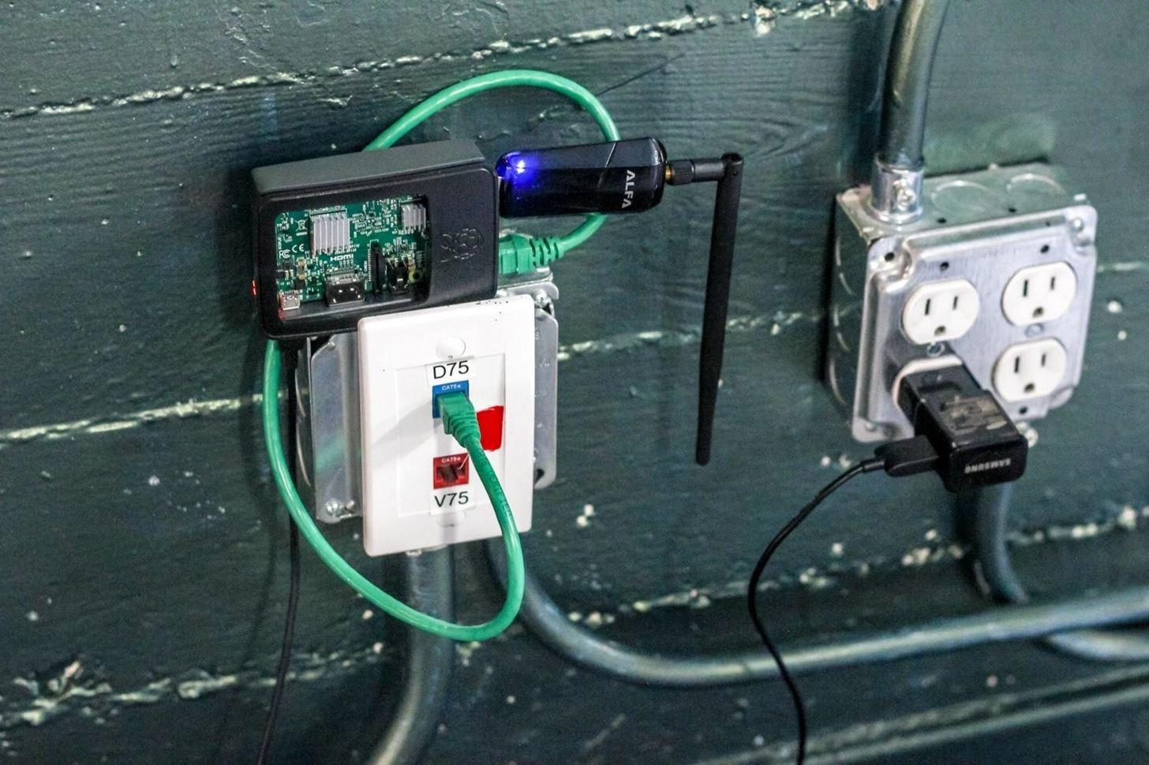
Advanced Wireless Network Security and Attacks
1.2 Common Attacks on Public Wi-Fi
Man-in-the-Middle (MitM) Attacks:
Definition: An attacker intercepts and potentially alters the communication between a user and the internet.
Example: Using a tool like Ettercap, an attacker can intercept login credentials transmitted over an unencrypted connection.
Rogue Hotspots:
Definition: Attackers set up fake hotspots to lure users into connecting.
Example: An attacker creates a hotspot named “Free Wi-Fi” which mimics a legitimate network. Once connected, all user traffic can be monitored.

Slide 4
Wireless Network Auditing Tools
Kismet:
Definition: A network detector, sniffer, and intrusion detection system.
Usage: Detects and identifies hidden networks and logs network traffic.
Example: Using Kismet, you can identify all nearby networks, including those that are not broadcasting their SSID.
Fern-Wifi-Cracker:
Definition: A tool for auditing wireless networks.
Usage: Can crack WEP, WPA, and WPA2 encryption keys.
Example: Using Fern-Wifi-Cracker, you can capture handshake packets and attempt to crack WPA/WPA2 passwords.

Slide 5
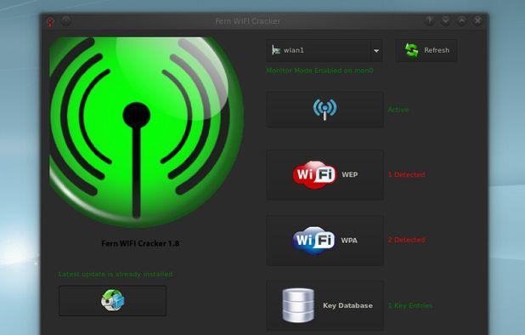
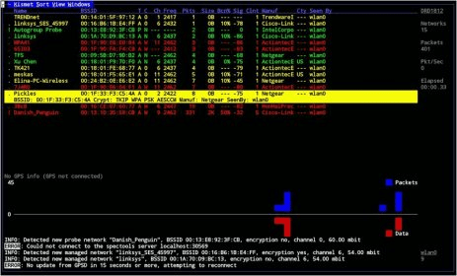
Practical Demo
Practical Demonstration:
Kismet Setup: Configure and run Kismet to detect networks.
Fern-Wifi-Cracker Usage: Demonstrate how to capture and crack a WPA2 password.

Slide 6
Deauthentication and Jamming Attacks
Introduction Deauthentication and jamming attacks are techniques used to disrupt wireless networks, either by forcing clients to disconnect or by creating noise that prevents communication.
2.1 Deauthentication Attacks
Definition:
Deauthentication Attack: A method where attackers send deauthentication frames to disconnect clients from a wireless network.
How It Works:
Tools: aireplay-ng is commonly used to perform deauthentication attacks.
Example: An attacker can use aireplay-ng to send deauthentication packets to a specific device, causing it to disconnect from the network.

Slide 7

Jamming Attacks
Definition:
Jamming: The act of creating interference on a frequency to disrupt
wireless communication.
Types of Jamming:
Constant Jamming: Continuously sends noise on a specific frequency.
Random Jamming: Sends noise intermittently.
Tools and Examples:
Tool: Wifite can be used to perform jamming attacks.
Example: An attacker uses Wifite to flood a frequency with noise, disrupting the network’s ability to communicate.

Slide 8
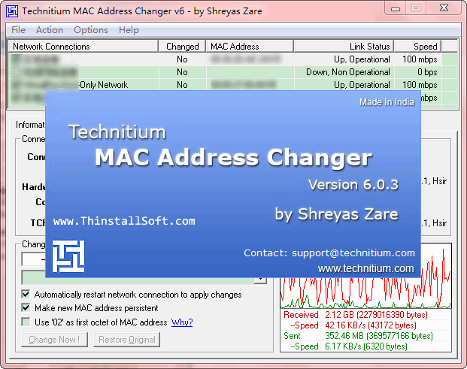
Evading MAC Address Filtering
Definition:
MAC Address Filtering: A security feature where only devices with specific
MAC addresses are allowed to connect.
Evading Techniques:
MAC Spoofing: Changing the MAC address of your device to bypass filtering.
Tool: Macchanger can be used to alter the MAC address of a device.
Example: Changing the MAC address of your device to match an allowed address and gain access to a restricted network.

Slide 9

Practical Demo
Aireplay-ng: Perform a deauthentication attack on a sample network.
Wifite: Demonstrate a jamming attack.
Macchanger: Show how to spoof a MAC address.

Slide 10
Wireless Network Intrusion Detection Systems (NIDS) and Cracking WPA3
Introduction Intrusion Detection Systems (IDS) and encryption protocols play a crucial role in maintaining wireless network security.
3.1 Wireless Network Intrusion Detection Systems (NIDS)
Definition:
NIDS: Monitors network traffic for suspicious activity and potential intrusions.
Examples and Tools:
Tool: Snort is an open-source NIDS used for network traffic analysis and intrusion detection.
Usage: Snort can be configured to detect patterns indicative of attacks such as port scans or unauthorized access attempts.
Example: Using Snort, you can create rules to detect unusual patterns in network traffic, such as multiple failed login attempts.

Slide 11

Cracking WPA3 Encryption
Definition:
WPA3: The latest Wi-Fi security protocol, providing improved security over WPA2.
Cracking WPA3:
Current Status: WPA3 is designed to be resistant to attacks, making it significantly harder to crack than WPA2.
Tools: Hashcat and John the Ripper are used for brute-force attacks on hashed passwords.
Example: Demonstrating the difficulty of cracking WPA3 by attempting a brute-force attack on a WPA3-encrypted network.
Practical Demonstration:
Snort: Set up Snort to monitor network traffic and identify suspicious activity.
Hashcat: Attempt to crack a WPA3 password (using a hash if WPA3 is implemented).

Slide 12
Protecting Your Own Wireless Network
Introduction Securing your own wireless network is critical to prevent unauthorized access and attacks.
4.1 Security Best Practices
Encryption:
WPA3: Use WPA3 for the strongest security.
WPA2: If WPA3 is not available, ensure WPA2 is used with a strong passphrase.
Network Configuration:
Disable WPS: Wi-Fi Protected Setup can be exploited; disable it if not needed.
Update Firmware: Regularly update your router’s firmware to patch vulnerabilities.

Slide 13
Legal Implications of Unauthorized Wireless Hacking
Definition:
Legal Risks: Unauthorized access to wireless networks is illegal and can result in criminal charges.
Examples:
Laws: The Computer Fraud and Abuse Act (CFAA) in the U.S. criminalizes unauthorized access to computer networks.
Penalties: Fines, imprisonment, and civil lawsuits.
4.3 Real-World Wireless Hacking Scenarios
Scenario 1: Rogue Hotspot Attack
Situation: An attacker sets up a fake Wi-Fi hotspot in a busy area.
Impact: Users connect to the fake hotspot, allowing the attacker to intercept sensitive information.

Slide 14

Deauthentication Attack in a Coffee Shop
Situation: An attacker uses a deauthentication attack to disrupt a coffee shop’s Wi-Fi.
Impact: Customers experience service disruptions and potential loss of connectivity.
Conclusion Understanding the techniques and tools used in wireless network security helps in both defending against and ethically testing network vulnerabilities. Always practice ethical hacking within legal boundaries and use your knowledge to enhance network security.

Slide 15
QnA from students
What are the primary security risks associated with public Wi-Fi hotspots?
Can you explain how a Man-in-the-Middle (MitM) attack works and what vulnerabilities it exploits?
How does Kismet help in detecting hidden networks, and what type of information does it provide?
What are the implications of connecting to a rogue hotspot, and how can a user protect themselves from such attacks?
What is a deauthentication attack, and how does it affect the targeted network?
Describe the difference between constant jamming and random jamming. How do each of these affect wireless communications?
What tools or methods would you use to perform a jamming attack, and what are the potential consequences for the network?
How can MAC address filtering be used to enhance network security, and what techniques can be used to bypass it?
If you were tasked with testing a network’s resilience to deauthentication attacks, what steps would you take?
What role does a Wireless Network Intrusion Detection System (NIDS) play in network security?
How does WPA3 differ from WPA2 in terms of security features, and why is it considered more secure?
What are some best practices for securing your own wireless network?

Slide 16
End of Today’s Lecture…..

